Slide 1
Overview of Tree Algorithms
from Decision Tree to xgboost
https://www.slideshare.net/tkm2261/overview-of-tree-algorithms-from-decision-tree-to-xgboost
1

Slide 2
Agenda
Xgboost occupied Kaggle
Decision Tree
Random Forest
Gradient Boosting Tree
Extreme Gradient Boosting(xgboost)
– Dart
2

Slide 3

Xgboost occupied Kaggle
More than half of the winning solutions in machine learning challenges hosted at Kaggle adopt XGBoost
http://www.kdnuggets.com/2016/03/xgboost-implementing-winningest-kaggle-algorithm-spark-flink.html
3

Slide 4
Awesome XGBoost
Awesome XGBoost: Machine Learning Challenge Winning Solutions
https://github.com/dmlc/xgboost/tree/master/demo#machine-learning-challenge-winning-solutions
Vlad Sandulescu, Mihai Chiru, 1st place of the KDD Cup 2016 competition. Link to the arxiv paper.
Marios Michailidis, Mathias Müller and HJ van Veen, 1st place of the Dato Truely Native? competition.
Link to the Kaggle interview.
Vlad Mironov, Alexander Guschin, 1st place of the CERN LHCb experiment Flavour of Physics competition. Link to the Kaggle interview.
Josef Slavicek, 3rd place of the CERN LHCb experiment Flavour of Physics competition. Link to the Kaggle interview.
Mario Filho, Josef Feigl, Lucas, Gilberto, 1st place of the Caterpillar Tube Pricing competition. Link to the
Kaggle interview.
Qingchen Wang, 1st place of the Liberty Mutual Property Inspection. Link to the Kaggle interview.
Chenglong Chen, 1st place of the Crowdflower Search Results Relevance. Link to the winning solution.
Alexandre Barachant (“Cat”) and Rafał Cycoń (“Dog”), 1st place of the Grasp-and-Lift EEG Detection. Link to the Kaggle interview.
Halla Yang, 2nd place of the Recruit Coupon Purchase Prediction Challenge. Link to the Kaggle interview.
Owen Zhang, 1st place of the Avito Context Ad Clicks competition. Link to the Kaggle interview.
Keiichi Kuroyanagi, 2nd place of the Airbnb New User Bookings. Link to the Kaggle interview.
Marios Michailidis, Mathias Müller and Ning Situ, 1st place Homesite Quote Conversion. Link to the Kaggle interview.
4

Slide 5
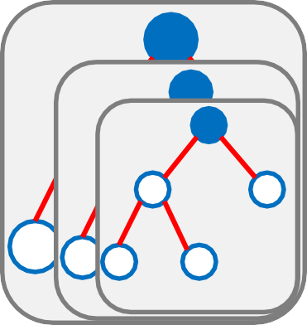
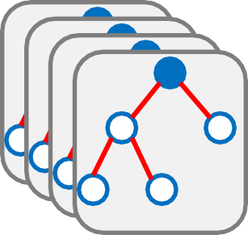
What’s happened?
XGBoost is a for Gradient boosting trees model
?
xgboost
Decision Tree
Random Forest
Gradient Boosting Tree
What’s happened during this evolution?
5

Slide 6
Decision Trees was the beginning of everything.
Definition.
Decision Trees (DTs) are a non-parametric supervised learning method used for classification and regression. The goal is to create a model that predicts the value of a target variable by learning simple decision rules inferred from the data features.
cited by http://scikit-learn.org/stable/modules/tree.html
cision ule 2
decision rule 3
Decision Tree
A | _{D} de r
 | B | E
C
decision rule 1
decision rule 4
6

Slide 7
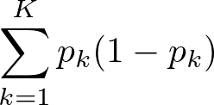
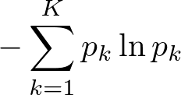

How were the rules found?
Set a metric that evaluates imputicity of a split of data. then minimize the metric on each node.
Classification
Gini impurity（CART）
Entropy （C4.5）
𝑝_{𝑘}: probability of an item with label 𝑘
𝐾 : number of class
Regression
Variance
𝑆𝐷(𝑆): standard varience of set S
𝑆_{𝐿}, 𝑆_{𝑅} : left and right split of a node
7

Slide 8
Examples
Classification
Predict a person survived or not from Titanic Dataset.
sex | age | survived
female | 29 | 1
male | 1 | 1
female | 2 | 0
male | 30 | 0
female | 25 | 0
male | 48 | 1
female | 63 | 1
male | 39 | 0
female | 53 | 1
male | 71 | 0
decide thresholds and
calculate probabilities
weighted average
Gini impurity
age | #survived | #people | probability | Gini impurity
age > = 40 | 3 | 4 | 0.75 | 0.375
age <40 | 2 | 6 | 0.33 | 0.444
0.42
0.08 Down
sex | #survived | #people | probability | Gini impurity
male | 2 | 5 | 0.40 | 0.480
female | 3 | 5 | 0.60 | 0.480
0.48
0.03 Down
Gini impurity: 0.5
8

Slide 9
Examples
Classification
Predict a person survived or not from Titanic Dataset.
sex | age | survived
female | 29 | 1
male | 1 | 1
female | 2 | 0
male | 30 | 0
female | 25 | 0
male | 48 | 1
female | 63 | 1
male | 39 | 0
female | 53 | 1
male | 71 | 0
decide thresholds and
calculate probabilities
weighted average
Entropy
age | #survived | #people | probability | Entropy
age > = 40 | 3 | 4 | 0.75 | -0.375
age <40 | 2 | 6 | 0.33 | -0.444
0.61
0.08 Down
sex | #survived | #people | probability | Entropy
male | 2 | 5 | 0.40 | 0.480
female | 3 | 5 | 0.60 | 0.480
0.67
0.02 Down
weighted average
Entropy
Entropy: 0.69
9

Slide 10
Examples
Regression
Predict age of a person from Titanic Dataset.
weighted average
Variance
sex | survived | age
female | 1 | 29
male | 1 | 1
female | 0 | 2
male | 0 | 30
female | 0 | 25
male | 1 | 48
female | 1 | 63
male | 0 | 39
female | 1 | 53
male | 0 | 71
calculate variances
survived | Var | #people
0 | 502.64 | 5
1 | 479.36 | 5
491.0
7.29 Down
sex | Var | #people
male | 524.56 | 5
female | 466.24 | 5
495.4
2.11 Down
Varience: 498.29
10

Slide 11
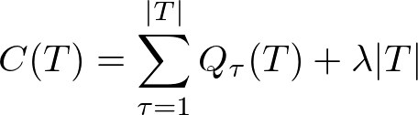
Other techniques for decision tree
Stopping Criteria
Maximum depth
Minimum leaf nodes
Finding a good threshold for numerical data
observed point of data
the point that class labels are changed
percentile of data
Pruning tree
Pruning tree when a subtree’s metric is above a threshold.
𝑇: a subtree of a original tree
𝜏: index of leaf nodes
Impurity metric
(gini, entropy or varience)
cited by PRML formula (14.31)
11

Slide 12
Random Forest
12

Slide 13
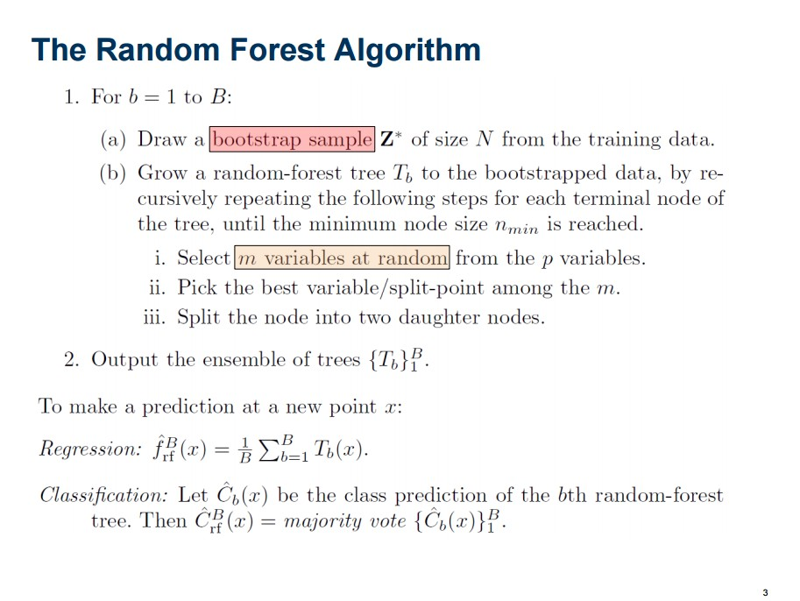
Random Forest
https://stat.ethz.ch/education/semesters/ss2012/ams/slides/v10.2.pdf
13

Slide 14
Main ideas of Random Forest
Bootstrapping data
Random selection of features
Ensembling trees
Average
Majority voting
14

Slide 15
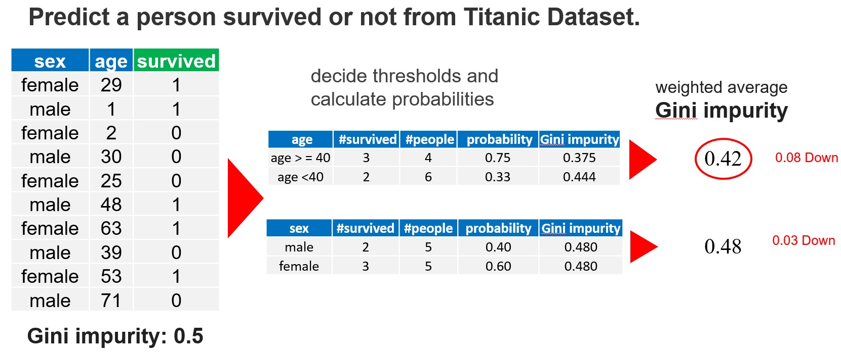
Random Forest as a Feature Selector
Random Forest is difficult interpreted, but calculate some kind of feature
importances.
Gain-based importance
Summing up gains on each split. (finally, normarizing all importances )
Above split, “Age” got 0.08 feature importance point.
15

Slide 16
Random Forest as a Feature Selector
Permutation-based importance
Decreasing accuracy after permuting each column
Original data
Permuted data
Target | Feat. 1 | Feat. 2 | Feat. 3 | Feat. 4
0 | 1 | 2 | 11 | 101
1 | 2 | 3 | 12 | 102
1 | 3 | 5 | 13 | 103
0 | 4 | 7 | 14 | 104
Target | Feat. 1 | Feat. 2 | Feat. 3 | Feat. 4
0 | 1 | 5 | 11 | 101
1 | 2 | 7 | 12 | 102
1 | 3 | 2 | 13 | 103
0 | 4 | 3 | 14 | 104
Accuracy: 0.8
Accuracy: 0.7
0.1 Down
Feature 2’s importance is 0.1.
16

Slide 17
Which importance is good ?
 | Pros. | Cons.
Gain-based importance | No need additional computing Implemented in scikit-learn | biased in favor of continuous variables and variables with many categories [Strobl+ 2008]
Permutation-based importance | Good for correlated variables? | Need additional computing
It is still a controversial issue.
If you want to learn more, please check [Louppe+ 2013]
17

Slide 18
Out-of-bag (OOB) Error
In random forests, we can get an unbiased estimator of the test error without CV.
Procedure to get OOB Error
All data
Remains data
(OOB data)
bootstraping
Loop for constructing trees
kth tree
Calucurate an error for the OOB data
Averaging the OOB errors by each data
18

Slide 19
Scikit-learn options
Parameter | Description
n_estimators | number of tree
criterion | "gini" or "entropy"
max_features | The number of features to consider when looking for the best split
max_depth | The maximum depth of the tree
min_samples_split | The minimum number of samples required to split an internal node
min_samples_leaf | The minimum number of samples required to be at a leaf node
min_weight_fraction_leaf | The minimum weighted fraction of the sum total of weights (of all the input samples) required to be at a leaf node.
max_leaf_nodes | Grow trees with max_leaf_nodes in best-first fashion.
min_impurity_split | Threshold for early stopping in tree growth.
bootstrap | Whether bootstrap samples are used when building trees.
oob_score | Whether to use out-of-bag samples to estimate the generalization accuracy.
warm_start | When set to True, reuse the solution of the previous call to fit and add more estimators to the ensemble, otherwise, just fit a whole new forest.
http://scikit-learn.org/stable/modules/generated/sklearn.ensemble.RandomForestClassifier.html
19

Slide 20
Gradient Boosting Tree (GBT)
20

Slide 21
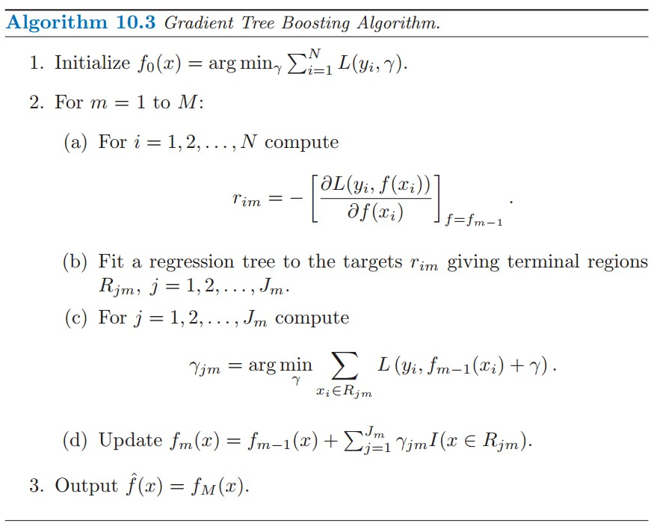
Gradient Boosting Tree (GBT)
psedo-residual
1-demantional optimization for each leaf.
The Elements of Statistical Learning 2nd edition, p. 359
21

Slide 22
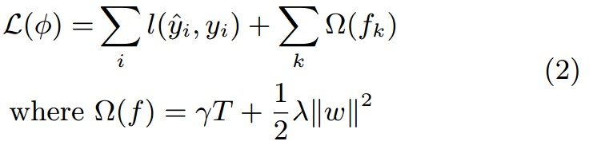

Xgboost(eXtreme Gradient Boosting)
xgboost is one of the implementation of GBT.
Splitting criterion is different from the criterions I showed above.
xgboost also implemented l1 regularization. (we see later.)
Loss function
number of leaves
Splitting criterion directly derived from loss function is the biggest contribution of xgboost.
22

Slide 23

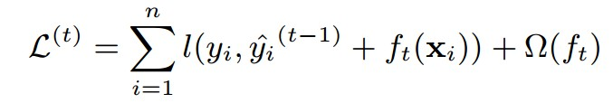

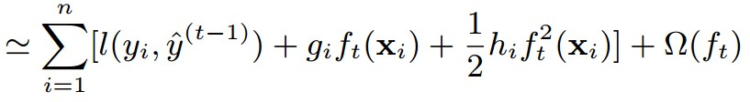
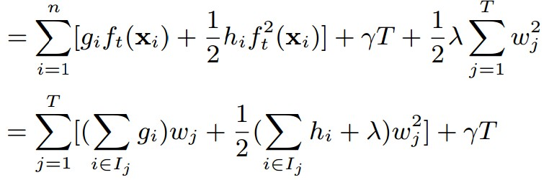
Xgboost’s Split finding algorithms
xgboost is one of the implementation of GBT.
Splitting criterion is different from the criterions I showed above.
Quadratic Approximation
First order gradient: Second order gradient:
23

Slide 24
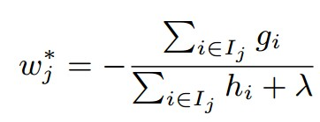
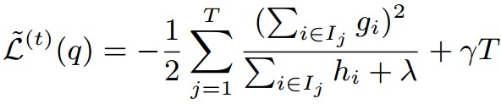
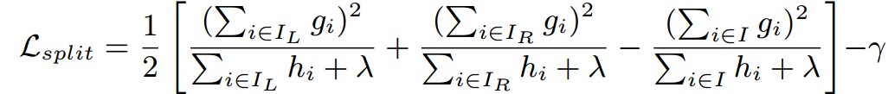
Xgboost’s Split finding algorithms
xgboost is one of the implementation of GBT.
Splitting criterion is different from the criterions I showed above.
Solve the minimal point by isolating w
Gain of this criterion when a node splits to 𝐿_{𝐿} and 𝐿_{𝑅}
This is the xgboost’s splitting criterion.
24

Slide 25
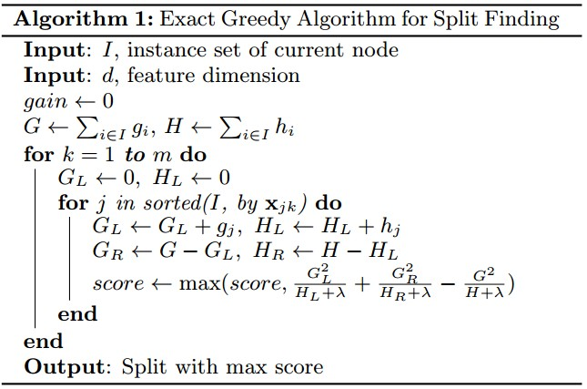
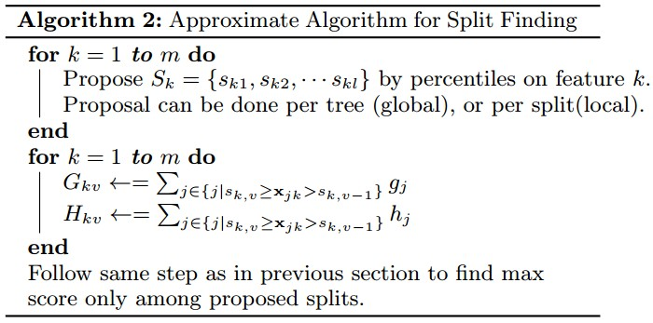
Xgboost’s Split finding algorithms
25

Slide 26
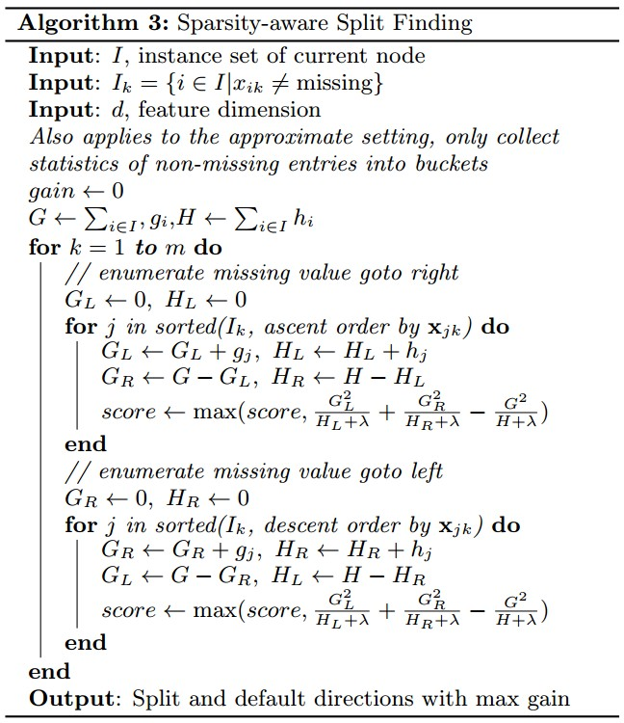
Xgboost’s Split finding algorithms for sparse data
26

Slide 27
Parameters of xgboost
27

Slide 28


Parameters of xgboost
eta [default=0.3, range: [0,1]]
– step size shrinkage used in update to prevents overfitting. After each boosting step, we can directly get the weights of new features. and eta actually shrinks the feature weights to make the boosting process more conservative.
Updating of shrinkage
𝜂
gamma [default=0, range: [0,∞]]
– minimum loss reduction required to make a further partition on a leaf node of the tree. the larger, the more conservative the algorithm will be.
If gamma is big enough, this term will be minus. (it does not cause a split)
https://github.com/dmlc/xgboost/blob/master/doc/parameter.md
28

Slide 29
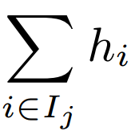
Parameters of xgboost
max_depth [default=6, range: [1,∞]]
maximum depth of a tree, increase this value will make model more complex / likely to be overfitting.
min_child_weight [default=1, range: [0,∞]]
minimum sum of instance weight(hessian) needed in a child. If the tree partition step results in a leaf node with the sum of instance weight less than min_child_weight, then the building process will give up further partitioning. In linear regression mode, this simply corresponds to minimum number of instances needed to be in each node. The larger, the more conservative the algorithm will be.
If
< min_child_weight
sum of instance hessian in leaf j
, then stop partitioning.
29

Slide 30

Parameters of xgboost
max_delta_step [default=0, range: [0,∞]]
– Maximum delta step we allow each tree's weight estimation to be. If the value is set to 0, it means there is no constraint. If it is set to a positive value, it can help making the update step more conservative. Usually this parameter is not needed, but it might help in logistic regression when class is extremely imbalanced. Set it to value of 1-10 might help control the update
If
> max_delta_step
, then
?
max_delta_step
I am not sure, please someone tells me.
30

Slide 31
Parameters of xgboost
subsample [default=1, range: (0,1]]
subsample ratio of the training instance. Setting it to 0.5 means that XGBoost randomly collected half of the data instances to grow trees and this will prevent overfitting.
colsample_bytree [default=1, range: (0,1]]
subsample ratio of columns when constructing each tree.
colsample_bylevel [default=1, range: (0,1]]
– subsample ratio of columns for each split, in each level.
31

Slide 32
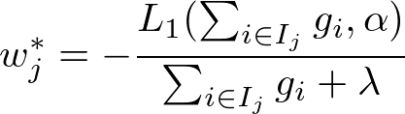
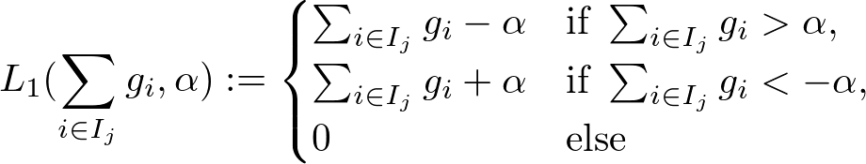
Parameters of xgboost
lambda [default=1]
– L2 regularization term on weights, increase this value will make model more conservative.
alpha [default=1]
– L1 regularization term on weights, increase this value will make model more conservative.
https://www.kaggle.com/forums/f/15/kaggle-forum/t/24181/xgboost-alpha-parameter/138272 https://github.com/dmlc/xgboost/blob/v0.60/src/tree/param.h#L178
32

Slide 33
Parameters of xgboost
tree_method [default='auto']
The tree construction algorithm used in XGBoost(see description in the reference paper)
Distributed and external memory version only support approximate algorithm.
Choices: {'auto', 'exact', 'approx'}
'auto': Use heuristic to choose faster one.
For small to medium dataset, exact greedy will be used.
For very large-dataset, approximate algorithm will be chosen.
Because old behavior is always use exact greedy in single machine, user will get a message when approximate algorithm is chosen to notify this choice.
'exact': Exact greedy algorithm.
'approx': Approximate greedy algorithm using sketching and histogram.
sketch_eps [default=0.03, range: (0, 1)]
This is only used for approximate greedy algorithm.
This roughly translated into O(1 / sketch_eps) number of bins. Compared to directly select number of bins, this comes with theoretical guarantee with sketch accuracy.
Usually user does not have to tune this. but consider setting to a lower number for more accurate enumeration.
Please see Algorithm 1 and Algorithm 2.
33

Slide 34

Parameters for early stopping
updater_seq, [default="grow_colmaker,prune"]
– A comma separated string mentioning The sequence of Tree updaters that should be run. A tree updater is a pluggable operation performed on the tree at every step using the gradient information. Tree updaters can be registered using the plugin system provided.
I am not sure the parameter, but the main developer also said
https://github.com/dmlc/xgboost/issues/1732
num_round
– The number of rounds for boosting
It counterparts of “n_estimator” in scikit-learn API.
34

Slide 35
Parameters for early stopping
early_stopping_rounds
– Activates early stopping. Validation error needs to decrease at least every <early_stopping_rounds> round(s) to continue training. Requires at least one item in evals. If there’s more than one, will use the last. Returns the model from the last iteration (not the best one). If early stopping occurs, the model will have three additional fields: bst.best_score, bst.best_iteration and bst.best_ntree_limit. (Use bst.best_ntree_limit to get the correct value if num_parallel_tree and/or num_class appears in the parameters)
If you have a validation set, you can tune boosting round.
feval
– Customized evaluation function
sample feval
def sample_feval(preds, dtrain):
labels = dtrain.get_label()
some_metric = calc_sume_metric(preds, labels)
return 'MCC', some_metric
https://github.com/dmlc/xgboost/blob/master/demo/guide-python/custom_objective.py
35

Slide 36
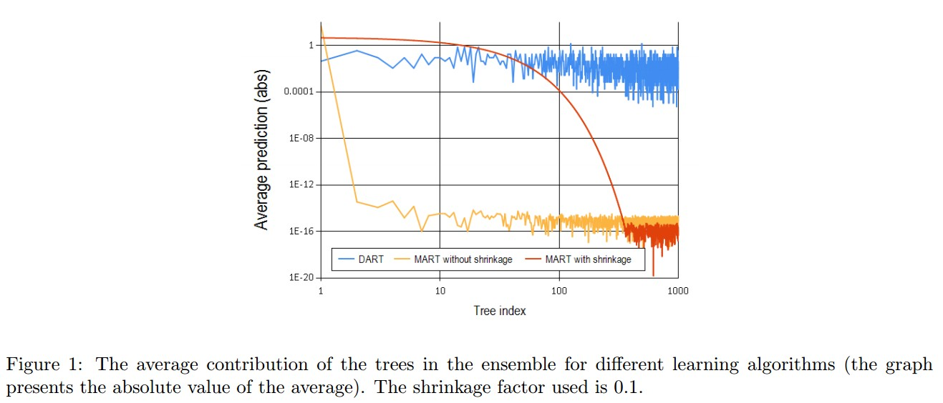

DART [2015 Rashmi+]
DART(Dropouts meet Multiple Additive Regression Trees)
Employing dropouts technique to GBT (MART)
DART prevents over-specialization.
Trees added at early have too much contribution to predict
Shrinkage also prevents over-specialization, but the authors claim not enough.
36

Slide 37
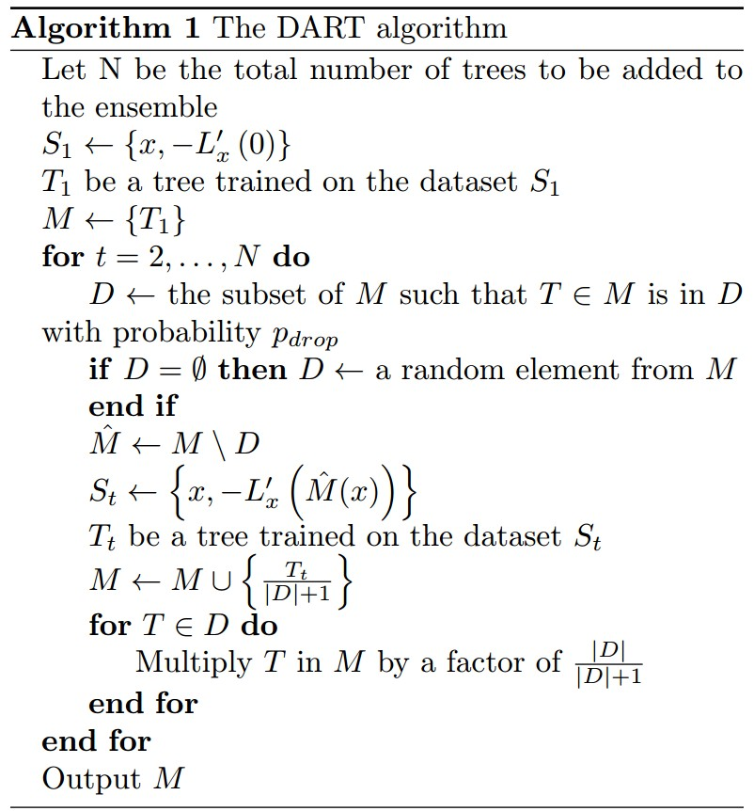
DART [2015 Rashmi+]
Deciding which
trees are dropped
Calcurating psedo-residual
Reducing the weights of dropped trees
37

Slide 38
Parameters for DART at xgboost
sample_type [default="uniform"]
type of sampling algorithm.
"uniform": dropped trees are selected uniformly.
"weighted": dropped trees are selected in proportion to weight.
normalize_type [default="tree"]
type of normalization algorithm.
"tree": new trees have the same weight of each of dropped trees.
weight of new trees are 1 / (k + learning_rate)
dropped trees are scaled by a factor of k / (k + learning_rate)
"forest": new trees have the same weight of sum of dropped trees (forest).
weight of new trees are 1 / (1 + learning_rate)
dropped trees are scaled by a factor of 1 / (1 + learning_rate)
rate_drop [default=0.0, range: [0.0, 1.0]]
dropout rate.
skip_drop [default=0.0, range: [0.0, 1.0]]
probability of skip dropout.
If a dropout is skipped, new trees are added in the same manner as gbtree.
38

